Slide 1

Sakina Lord | STA478

Slide 2
The Data
Matches
Each row is one match of a tournament
2005 - 2022
  Day # of Tournament
  Date
  Home & Away Teams
  Team lineups
  Whether or not match was delayed
  Home and Away Scores
Players
Each row is one year of Top14 play
1084 different players
  Birthday
  Position
  Team
Play metrics
  Matches played
  Total time played
  Penalty scores, Tries, Conversions
  Red/yellow cards

Slide 3
The Data
Joined
Each row is one match/player combination with their metrics for that season and the outcome of the match
2005 - 2022
  Day # of Tournament
  Date
  Winning team
  Score difference
  Player metrics
Missing stats for 102,854 players
~70% of rows have 11 fields missing

Slide 4
Imputation
Diagnose Missingness
Select method & Impute
Assess imputed data
MAR
MNAR
MCAR
Should we impute?
What method should be used?
In the mice package
Random Forest
Predictive mean matching
Bayesian linear regression
Uses other predictors as predictors for a possible value for what is missing
Variable distributions
Bivariate relationships
Correlation structure
When using mice
Check chain convergence
Notes:
Multivariate Imputation by Chained Equations.
PMM <- matches observed values to predicted values from a regression model. It selects a value from the observed data that is closest to the predicted value for the missing data,

Slide 5
Diagnose Missingness
MAR
MCAR
MNAR
Missingness depends on observed values, not on the missing values themselves
Controlling for observed values shows missingness is random
Missingnes is NOT related to other predictors or the response variable
Dropping missing rows will not bias the data
Missingness depends on the missing values themselves
Systemic in how the data is gathered
*Other types of missingness exist, but these are the big considerations when using `mice` package
Notes:
1. MCAR (Missing Completely At Random)
Missingness is unrelated to any variables (observed or unobserved)
Implication: You can just delete missing cases (complete case analysis) without bias, though you lose power
Imputation: Any reasonable method works fine
Example: Data lost due to random equipment failure
2. MAR (Missing At Random)
Missingness depends on observed variables, not the missing values themselves
Implication: Complete case analysis is biased, but imputation using observed variables works
Imputation: Standard methods (multiple imputation, ML) are valid and can recover unbiased estimates
Example: Older people more likely to skip income questions, but among same-age people, missingness is random
3. MNAR (Missing Not At Random)
Missingness depends on the unobserved (missing) values themselves
Implication: Standard imputation methods produce biased results
Imputation: Need specialized methods (selection models, pattern mixture models) or sensitivity analyses
Example: High earners refuse to report income

Slide 6
Select method & Impute
*This is an incomplete list
**MICE - Multivariate Imputation by Chained Equations
mean imputation
Drop missing values
MCAR
Numeric target
pmm
norm
polyreg
rf
Any method
MAR
Available with MICE**
Type of Missingness
Multiple imputation
Categorical target
MNAR
Selection models
Sensitivity analysis
Specialized methods
Notes:
MICE - Multivariate Imputation by Chained Equations

Slide 7
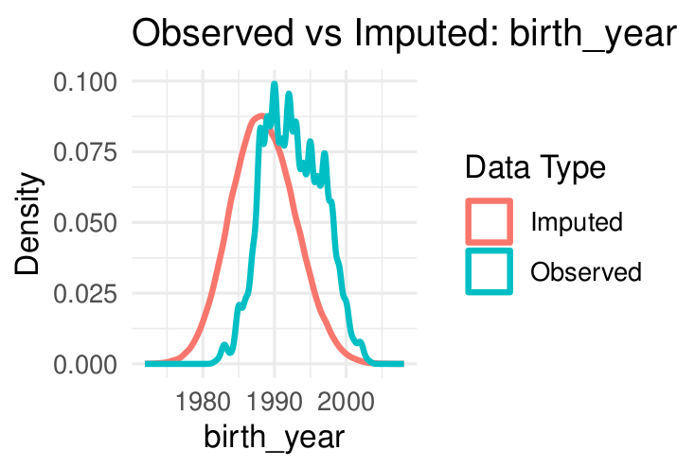
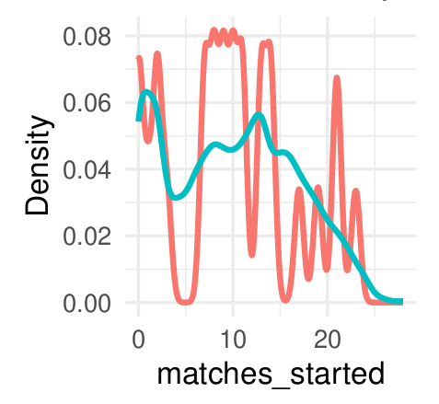
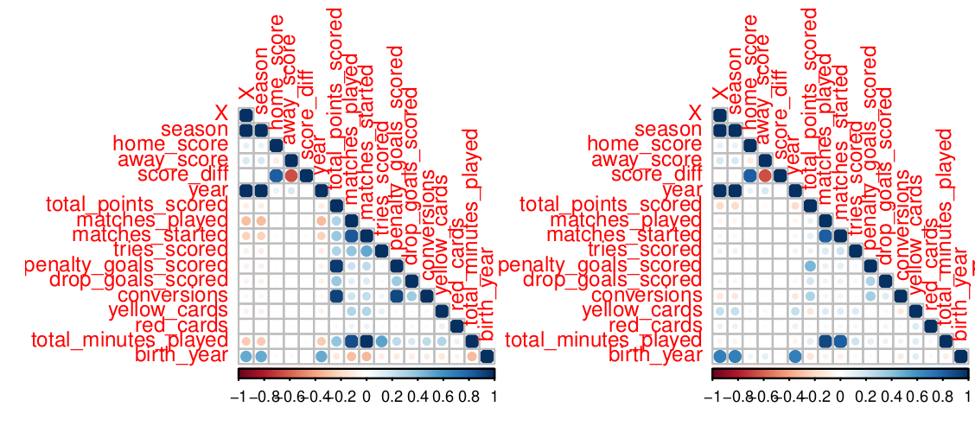
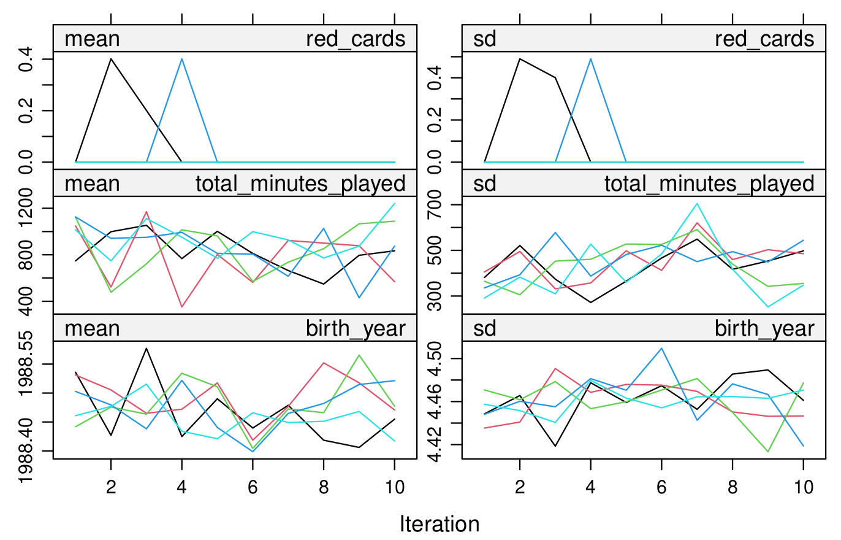
Assess imputed data
Distributions
Correlation Structure
Chain Convergence

Slide 8
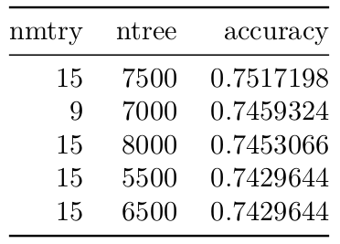
Predictive
Random forest - Predict whether the home team wins with 73%
K-fold CV shows:
15 = best number of parameters to use
7500 = best number of trees
Day of match -> Most important predictor

Slide 9
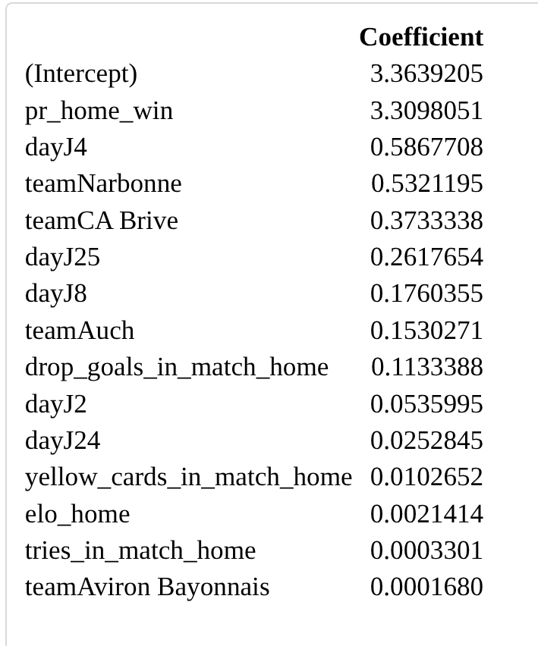
Interpretable
Elastic Net predicting a home win.
2nd best performing model (after RF)

Slide 10
Sources
Sas, W. (21 July, 2025). Elo Calculator. Omni Calculator https://www.omnicalculator.com/sports/elo
Van Buuren, S. (2018). Flexible Imputation of Missing Data https://stefvanbuuren.name/fimd/sec-pmm.html
Buuren, S. (27 May, 2025). Multivariate Imputation by Chained Equations. https://cran.r-project.org/web/packages/mice/refman/mice.html#mice
Enders, C. (2024). Modern Missing Data Analysis. CenterStat. [Lecture Notes] https://centerstat.org/wp-content/uploads/2024/04/MISS-Notes.pdf
ISLR Version 2

